Slide 1
Python: Functions Continued
Lesson 7

Slide 2
Review Questions

Slide 3

Which line of the code is where the parameters are?
You can see the line of code by looking at the left edge of the screenshot.
Line 1
Line 2
Line 3
Line 5
Answer: A - Line 1

Slide 4
Which line of the code is where the return is?
You can see the line of code by looking at the left edge of the screenshot.
Line 1
Line 2
Line 3
Line 5
Answer: C - Line 3

Slide 5
Which line of the code is where the function call is?
You can see the line of code by looking at the left edge of the screenshot.
Line 1
Line 2
Line 3
Line 5
Answer: D - Line 5

Slide 6
Which lines of the code are the function body?
Pick 2 answers.
Line 1
Line 2
Line 3
Line 5
Answer: B & C - Lines 2-3

Slide 7
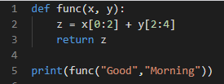
What would be outputted from this program?
It will give an error
Goorni
Gorn
ooni
Answer: C - Gorn

Slide 8
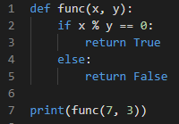
What would be outputted from this program?
It will give an error
False
True
1
Answer: B - False

Slide 9
Function Scope

Slide 10
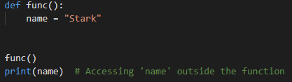
Data Lifecycle
In Python, data created inside the function cannot be used from the outside unless it is being returned from the function.
Variables in a function are isolated from the rest of the program. When the function ends, they do not exist anymore and cannot be used in the program. For example, this would not work:

Slide 11
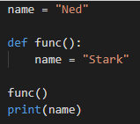
Data Lifecycle
A function also can’t access data outside its scope unless the data is in an argument. For example, the output of the program to the right would be Ned, as the variable name in the function is a local variable - it only exists inside that function.

Slide 12
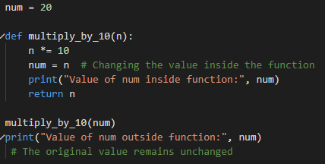
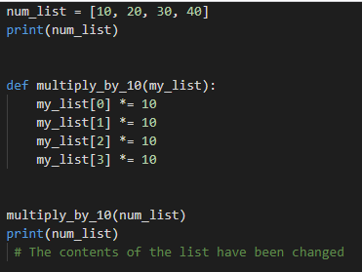
Altering Data
Some data is immutable (strings, numbers, etc.) while some are mutable (arrays, for example). You cannot update an immutable variable with a function, but a mutable variable can be updated with a function.
Immutable variable example
Mutable variable example
Output: 20
Output: [100, 200, 300, 400]

Slide 13
Questions - True or False
Variables inside a function can be accessed outside the function.
True False
Numbers are immutable, while lists are mutable.
True False

Slide 14
Built-in Functions

Slide 15
Strings
Functions that are properties of a particular entity are known as methods. These methods can be accessed using the . operator. Here are some of the methods associated with strings:
a_string.find(substring, start, end) Finds the index of the substring substring in the string a_string. start and end are optional, they restrict the search.
a_string.replace(substring_to_be_replace, new_string) Replaces the substring substring_to_be_replace with the substring new_string.
a_string.upper() and a_string.lower() Changes all letters to uppercase. Changes all letters to lowercase.

Slide 16
Type Conversions
Python can also convert variables into different types using functions. Some ways are:
int() - converts data into an integer (a string can only be converted if it’s made up of numbers; a boolean will be either a 0 or 1)
float() - converts data into a floating-point number
str() - converts data into a string
bool() - converts data into a Boolean (strings are always True unless empty, and numbers are True unless they are zero)

Slide 17
Practice Questions

Slide 18
What will be displayed from this program?
var1 = “12” var2 = int(var1) print(var2 + 34)
Error
var2
46
34
Answer: C - 46

Slide 19
What will be displayed from this program?
var1 = 987654 var2 = str(var1) print(var2[1:4])
8765
876
9876
98765
Answer: B - 876

Slide 20
What will be displayed from this program?
var1 = “” var2 = 82 var3 = bool(var2) and bool(var1) print(var3)
Error
82
True
False
Answer: D - False

Slide 21
What will be displayed from this program?
var1 = True var2 = “Hello There!” var3 = len(var2) + int(var1) var3 /= 2 print(var3)
12
6
6.5
False
Answer: C - 6.5

Slide 22
Lambdas

Slide 23
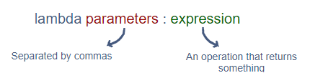
Lambdas
A lambda is an anonymous function that returns some form of data. They are defined using the lambda keyword. Since they return data, it is usually assigned to a variable.
The following syntax is used to make a lambda. The parameters are separated by commas and they are optional.

Slide 24


Lambdas
The code above triples the value of the parameter num and returns the new value. For example, in this case, the output would be 30, 3 times 10.
The lambda below concatenates (joins) the first characters of 3 strings together. In this case, the output would be “WWW”.

Slide 25

Limitations of Lambdas
The limitation of lambdas is that they can only have a 1 line expression. Lambdas are very good for single line functions. Also, conditional statements can be used like this:
This will output “High” if num is greater than 50, otherwise it will output “Low”.
For conditionals, there must be an if and an else. Both cases need to be covered, otherwise the lambda will throw an error.
Lambdas are very useful when used as an argument for another function (we will cover this later).

Slide 26
What will be displayed from this program?
my_func = lambda num: num % 2
print(my_func(9))
9
1
0
num
Answer: B - 1

Slide 27
What will be displayed from this program?
my_func = lambda x, y, z: x * y * z
print(my_func(5, 2, 4))
10
24
60
40
Answer: D - 40

Slide 28
What will be displayed from this program?
check = lambda age: “OK” if age > 17 else “Too Young”
print(check(15))
It will give an error
False
Too Young
OK
Answer: C - Too Young

Slide 29
What will be displayed from this program?
my_func = lambda num: “Even” if num % 2 == 0 else “Odd”
print(my_func(9))
It will give an error
1
Even
Odd
Answer: A - It will give an error

Slide 30
What will be displayed from this program?
check = lambda val: “Good” if val = 40
print(check(15))
It will give an error
False
15
Good
Answer: C - Too Young

